Slide 1

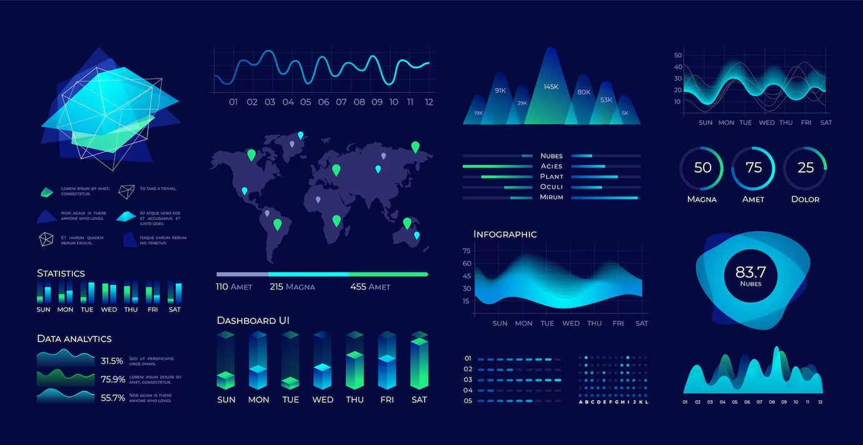

DataFlow: An SQL LLM Agent for Intelligent Database Interaction
An intelligent assistant enabling natural language queries on SQL databases.
Presented By:
Utkarsh Prajapati (2101660100061)
Anish Chauhan (2101660100013)
Adarsh (2101660100007)
Anshil Gautam (2101660100017)
Department of Computer Science & Engineering
Dr. Ambedkar Institute of Technology for Divyangjan (AITD), Kanpur
Notes:
1

Slide 2

The Challenge: Why Is Database Interaction Often Difficult?
Technical Barrier
Complexity
Data Accessibility
SQL requires specialized knowledge, limiting access for many users.
Manual query writing is error-prone and time-consuming.
Non-technical users struggle to retrieve meaningful insights from data.
Notes:
2

Slide 3

Our Solution: DataFlow – Your Intelligent Database Assistant
Natural Language Queries
Translate plain English questions into optimized SQL queries.
Insight Generation
Provide meaningful summaries beyond raw data results.
Direct SQL Execution
Support advanced users with direct command input and confirmation.
Schema Awareness
Dynamically fetch and use database structure for accurate queries.
Notes:
3

Slide 4


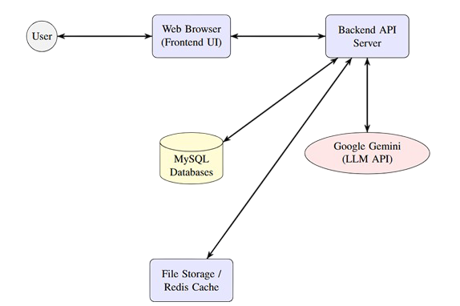



System Architecture & Workflow
User Input
Natural language or direct SQL commands via chat interface.
Backend Processing
Schema fetching, SQL generation, and query execution.
LLM Integration
Google Gemini API generates SQL and insights.
Results & Insights
Display query results and AI-generated summaries to users.
Notes:
4

Slide 5
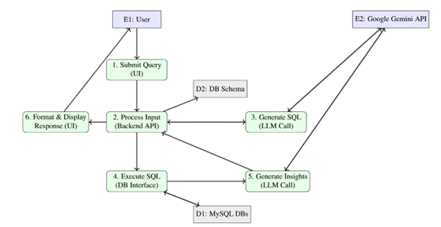
Operational Workflow: Question to Answer
User Submits Query (UI)
2
Backend Processes Input (Schema, LLM Prompt)
3
Gemini API Generates SQL
4
SQL Execution (DB Interface)
5
Gemini API Generates Insights
6
Results Formatted & Displayed (UI)
Notes:
4

Slide 6

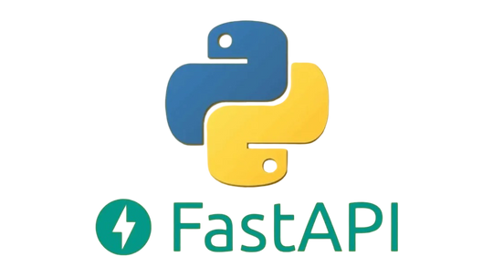


Technologies Powering DataFlow
Backend
Frontend
Data & Testing
Python, FastAPI, MySQL Connector
HTML, Tailwind CSS, JavaScript
MySQL databases (SQLLLM, StoreDB)
Google Gemini API for LLM capabilities
Interactive chat interface
Faker library for sample data generation
Notes:
5

Slide 7
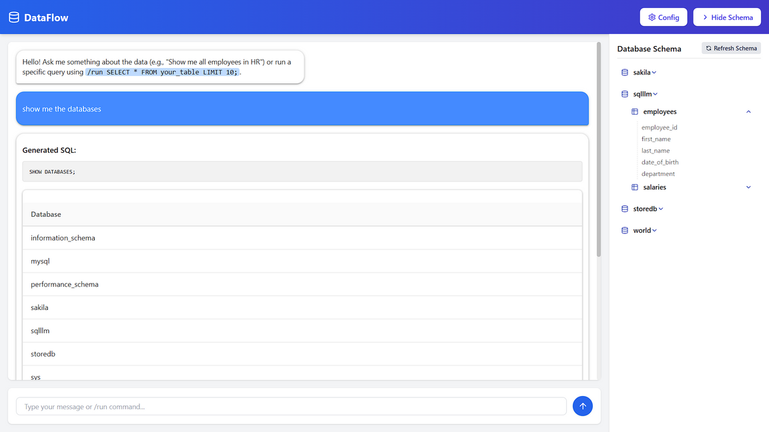
User Experience: Chat Interface & Powerful Insights
Conversational Chat
Users type questions or SQL commands in a familiar chat layout.
Schema Display
Toggleable panel shows databases, tables, and columns.
Insightful Responses
Results include generated SQL, data tables, and AI insights.
Error Handling
Clear messages guide users on invalid inputs or failures.
Notes:
6

Slide 8

Demonstration & Testing Setup
Manual & Black Box Testing
Extensive input-output validation from user perspective.
Integration Testing
Ensured smooth interaction between frontend, backend, LLM, and DB.
Sample Data Generation
Used Faker to create realistic test databases for demonstrations.
Error & Usability Checks
Tested error messages and interface clarity.
Notes:
7

Slide 9



Achievements & Future Roadmap
Future Enhancements
Support more SQL databases (PostgreSQL, SQL Server)
Advanced security and user authentication
2
Current Achievements
Conversational context and multi-turn queries
1
Natural language to SQL translation, schema awareness, chat UI.
Data visualization and saved queries
3
Long-Term Vision
Conversational, context-aware, and secure data interaction platform.
Notes:
8

Slide 10

Thank You
We appreciate your time and interest in DataFlow.
Questions and feedback are welcome.
Notes:
9

